Slide 1
Lesson 2: Variables
Year 7 – Programming essentials in Scratch: part I
Notes:
Last updated: 24-05-21
This resource is licensed under the Open Government Licence, version 3. For more information on this licence, see ncce.io/ogl.

Slide 2
Story time
Starter activity
The story that you are about to hear has some words that you will hear a number of times.
As a class, pick what you want these words to be. You MUST remember them:
COUNTRY = VILLAIN =
TOWN = SISTER =
HERO =

Slide 3
Story time
Starter activity
Computers are good at storing data and remembering it.
It is your job in this activity to play the role of the computer.
As a computer programmer, use variables to link data to a word.
You will take it in turns to try and remember all of the data that has been defined against the variable names.
Our variables:
COUNTRY =
TOWN =
HERO =
VILLAIN =
SISTER =

Slide 4
Part 1
Starter activity
In a faraway land called [COUNTRY].
There was a magical and mysterious castle in the town of [TOWN].
It was said that behind the castle walls was a magical princess called [HERO].
[HERO] tried to hide her powers from the people of [TOWN], but there was curious prince called Prince [VILLAIN] who found out about these powers and forced [HERO] to run away.
Notes:
Read the story to the class and point to the learner you want to say a stored word when you reach a variable. For example, if the class had decided that the country should be Greece, they should say the word “Greece” instead of country.

Slide 5
Part 2
Starter activity
[HERO] ran way, and imposed an endless winter on [TOWN].
Her sister [SISTER] set off on a dangerous adventure to help [HERO] return to [TOWN].
Notes:
Read the story to the class and point to the learner you want to say a stored word when you reach a variable. For example, if the class had decided that the country should be Greece, they should say the word “Greece” instead of country.

Slide 6
Interlude
Starter activity
Our story has moved on to a new TOWN and therefore we are going to change the data that TOWN currently refers to.
TOWN =

Slide 7
Part 3
Starter activity
[SISTER] found her way to [TOWN] where her sister had used her magical powers to build a palace of ice.
Along the way, [SISTER] had to overcome many challenges and met a new snowman friend.
Notes:
Read the story to the class and point to the learner you want to say a stored word when you reach a variable. For example, if the class had decided that the country should be Greece, they should say the word “Greece” instead of country.

Slide 8
Interlude
Starter activity
For the end of our story, we need our HERO and SISTER to return back to the original TOWN.
As variables don’t hold more than one item at a time and don’t remember any previous values, make sure the data linked to TOWN is changed again.
TOWN =
Notes:
In practice, if we had two towns we would use two variables (one for each town), however, we are using one to help avoid a common misconception as outlined in the second paragraph.

Slide 9
Part 4
Starter activity
[SISTER] and [HERO] work together to put the nasty [VILLAIN] in jail.
[HERO] and [SISTER] returned to [TOWN] to save [COUNTRY] from an eternal winter.
THE END

Slide 10
Variables
Starter activity
A variable is a name that refers to data being stored by the computer
Q1. In the exercise, what were the variables?
Q2. Did any of the variables store more than one item of data at the same time?
Think/pair/share
Notes:
Define the term “variable” formally to the class. Make sure that it is highlighted that the name refers to data being stored by the computer to help address the common misconception M3: a variable is merely a pairing of a name with a value. It is not stored within the computer. The data was only stored once and yet the learners retrieved the data from their brain when it was needed, much like a computer would retrieve the data from its memory (RAM).
Allow time for learners to think and write down the answers to the questions before discussing their answers with the person next to them. Go through the answers with the class.
Q2. addresses misconception M1: a variable can store multiple values; it may store the history of values assigned to it. Highlight that we had to redefine the TOWN variable twice as we wanted it to store different data. It did not hold both at the same time, or remember the previous value it stored.

Slide 11

Lesson 2 : Variables
Objectives
In this lesson, you will:
Define what a variable is
Recognise that computers follow the control flow of input/process/output
Predict the outcome of a simple sequence that includes variables
Trace the values of variables within a sequence
Make a sequence that includes a variable

Slide 12

Input — process — output
Activity 1
INPUT
PROCESS
OUTPUT
STORAGE
Notes:
Last lesson, the learners were introduced to the terms: sequence, selection, and iteration. Highlight to the learners that these are all processes, but for computers to perform tasks there is more that is needed. Often a computer will take inputs (this might be automatic or via human input) as well as producing an output. A good example of this would be to show the learners that when you use a keyboard and mouse, it inputs data into the computer to be processed and the output is visible on the computer monitor.
Highlight to the learners that storage is also important (as clear from the starter activity). The computer stores data and needs to retrieve it to be processed at the appropriate times.

Slide 13
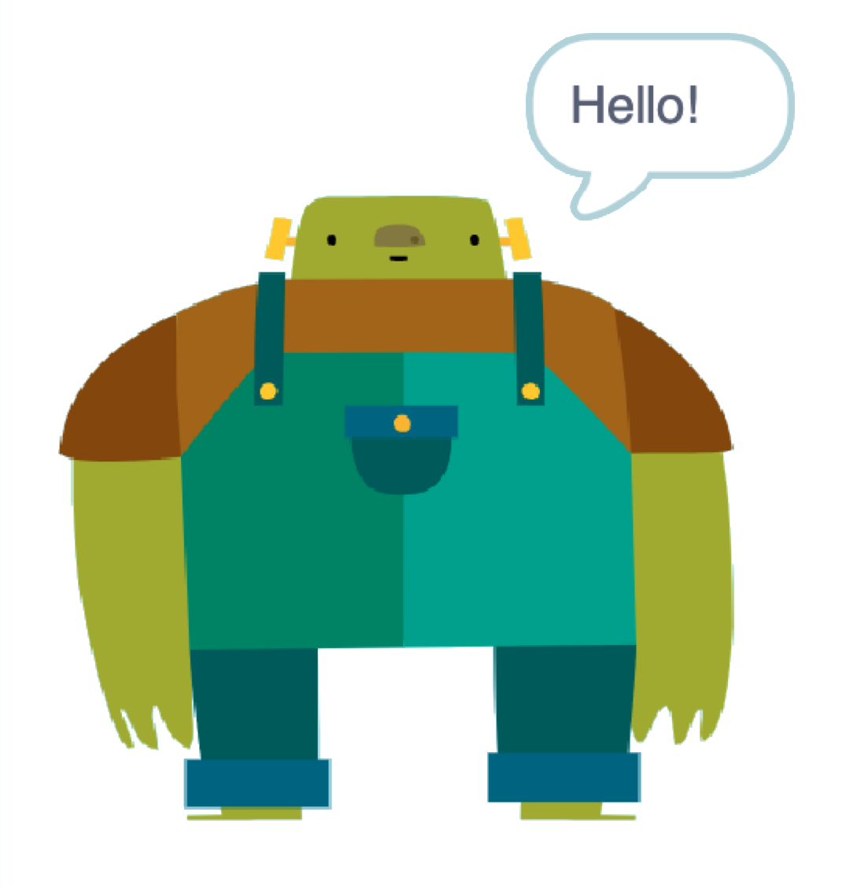
Meet Big Ed
Activity 2
Big Ed is your friendly chatbot.
Your task is to work in pairs to answer the questions on the activity sheet. You’ll find out what the code does and have the chance to experiment with it.
Start by opening the Scratch program.
ncce.io/biged1

Slide 14
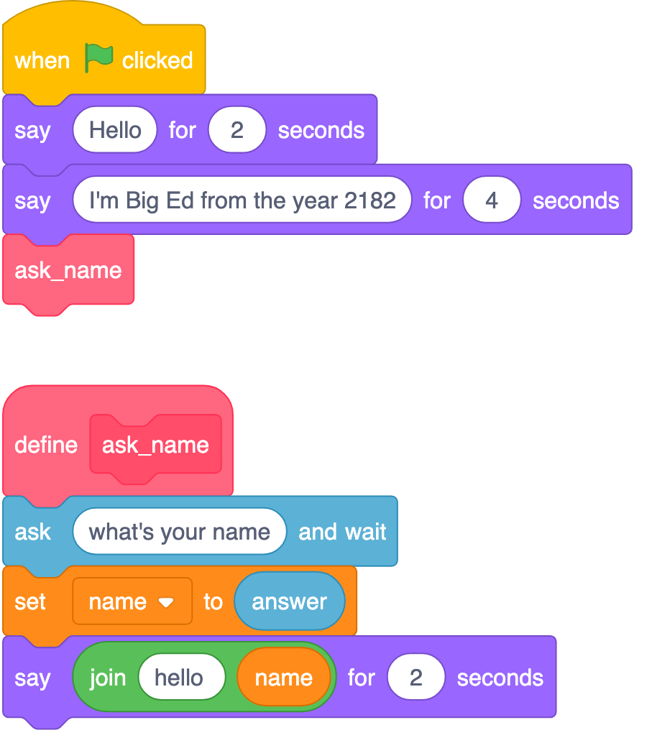
PREDICT
Activity 2
With a partner, spend time reading the code on the right. Predict what you think will happen.
Run the Scratch code from the link provided.
Were your predictions correct?
Did anything surprise you about the code?
Did you miss anything out?
ncce.io/biged1

Slide 15
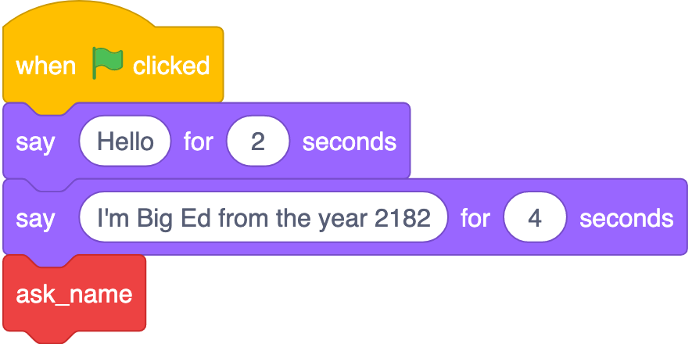
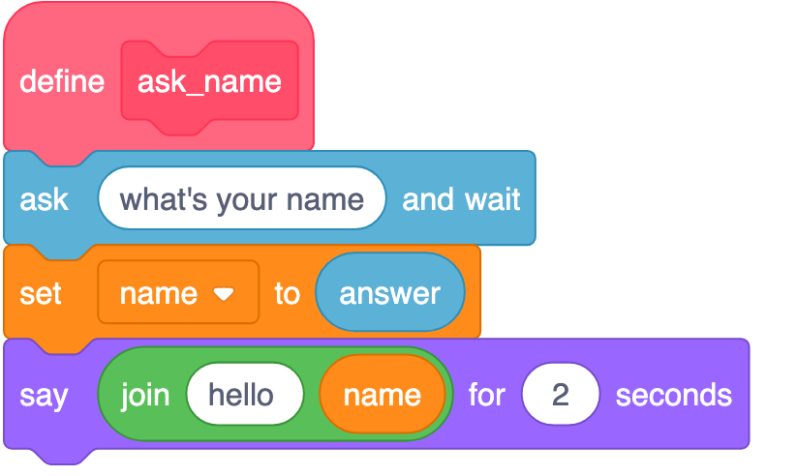

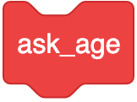
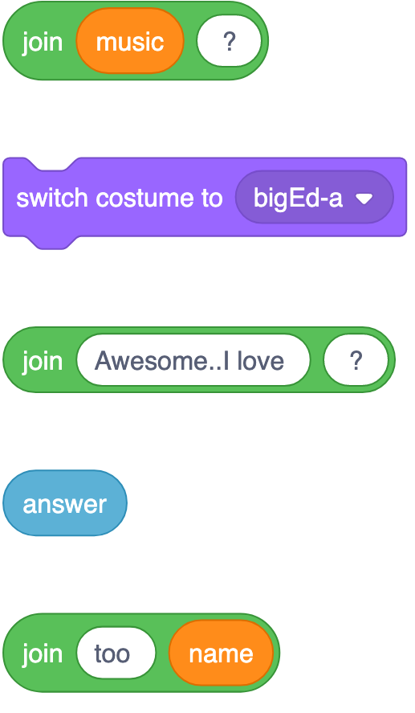
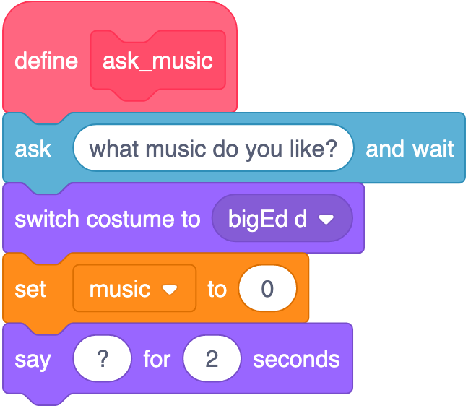
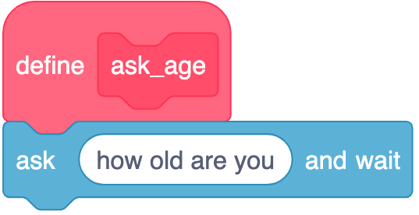
Worksheet: INVESTIGATE and MODIFY
Activity 2
Continue with the worksheet.
Work in pairs, but complete your own worksheet.
Follow the instructions and investigate how the code works.
Move through the tasks independently.
Don’t wait for your teacher to instruct you to move to the next section.
ncce.io/biged1

Slide 16
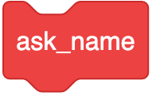
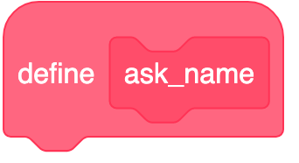
INVESTIGATE: Answers
Activity 2
How do the following two blocks relate to each other?
When your program reaches the ask_name block, it calls the subroutine ‘define ask_name’.
‘define ask_name’ is a subroutine.
Notes:
Make sure that at this stage you introduce the correct terminology. The learners might have accurately said that the ask_name block runs the “define ask_name” block. Although this is correct, introduce the recognised vocabulary that the ask_name block “calls” the “subroutine”.

Slide 17
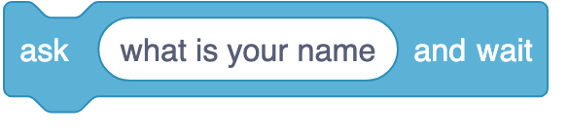
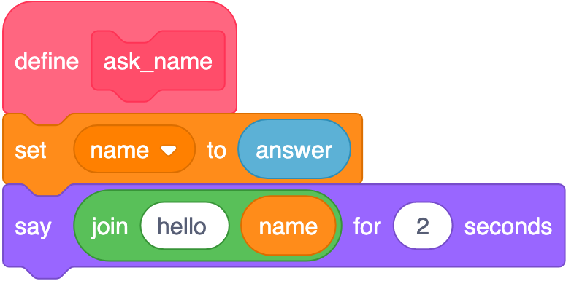
INVESTIGATE: Answers
Activity 2
What has this changed about the program when you run it?
Why do you think this is?
Big Ed will now only say “Hello”.
As the question has not been asked, there is no ‘answer’.
The line ‘set name to answer’ will now give name an empty value.

Slide 18
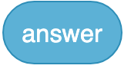
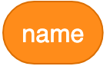
INVESTIGATE: Answers
Activity 2
Below ‘define ask_name’, there are two variables being used.
What are their names?
Answer
Name
Notes:
Learners might have missed “answer” as a variable because there’s no line that “sets” the answer variable specifically. This is unique to Scratch. Even though the creation of the variable is hidden in Scratch, it still exists. As the variable “answer” is being used in other subroutines it’s worth setting a name variable that will refer to the answer to this specific question.

Slide 19
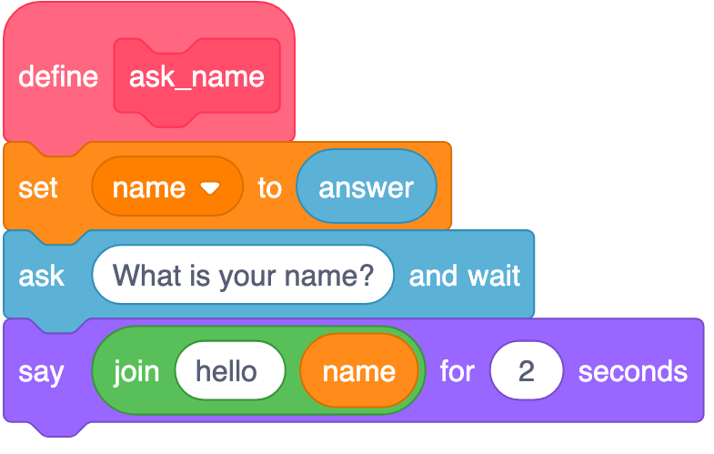
INVESTIGATE: Answers
Activity 2
Why do you think it only says “Hello” and not “Hello” and the name you entered?
What can you learn from this?
It is because ‘name’ is being linked to ‘answer’ before the question is asked.
You must always set the value of a variable before using it.

Slide 20
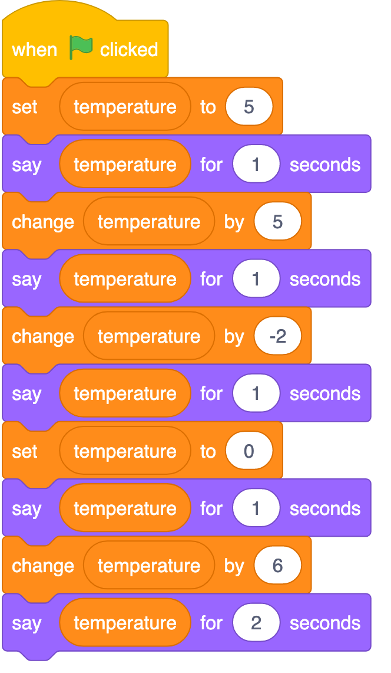
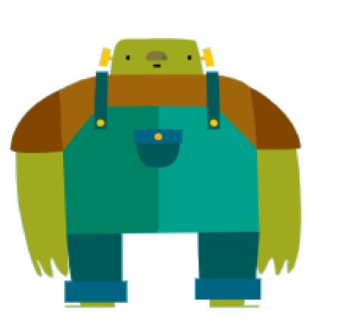
Trace the temperature variable: What will Big Ed say?
Plenary
Big Ed has just arrived on a new planet and he’s measuring the temperature of his new environment.
Use the activity sheet to trace (keep track of) the value of the temperature variable on each line that it is referenced.
Fill in your activity sheet and write down what Ed will say on each line.

Slide 21
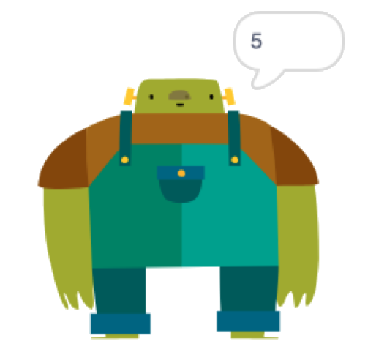
Trace the temperature variable: What will Big Ed say?
Plenary

Slide 22
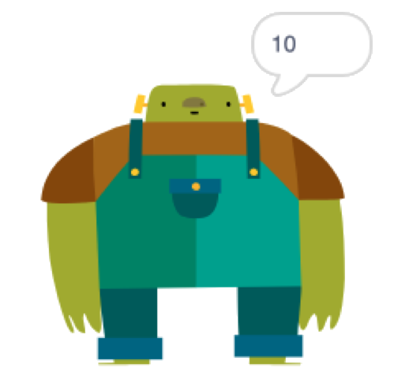
Trace the temperature variable: What will Big Ed say?
Plenary

Slide 23
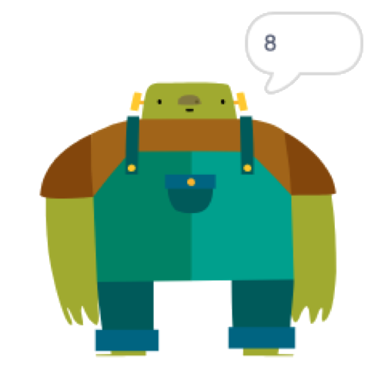
Trace the temperature variable: What will Big Ed say?
Plenary

Slide 24
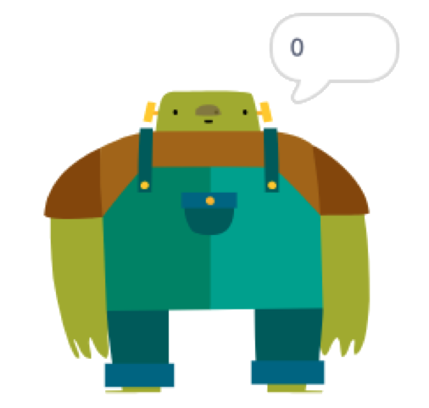
Trace the temperature variable: What will Big Ed say?
Plenary

Slide 25
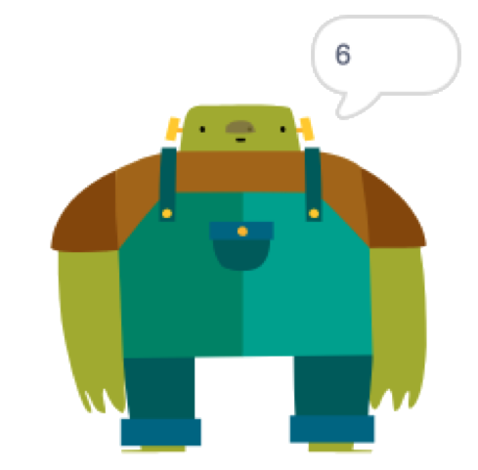
Trace the temperature variable: What will Big Ed say?
Plenary

Slide 26
Next lesson
Summary
In this lesson, you…
Defined a variable
Recognised that computers follow the control flow of input/process/output
Predicted the outcome of a simple sequence that includes variables
Traced a variable within a sequence
Next lesson, you will…
Learn about how to control the flow of a sequence using selection

